Slide 1
Finding Hughie Windmon –Windom-Windman-Windham-Winburn-Windburn-Winton… in 1920
Find every census record…

Slide 2
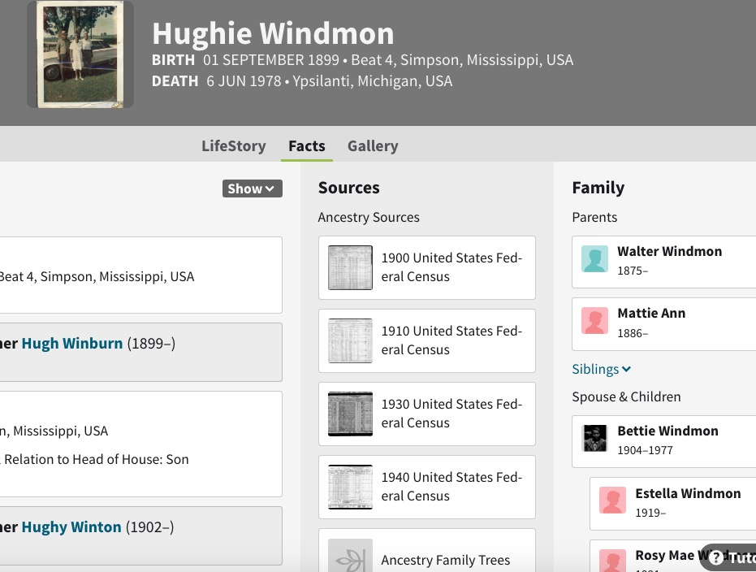
Start with what you know
Betty Phillips
1st ch b. 1919?

Slide 3
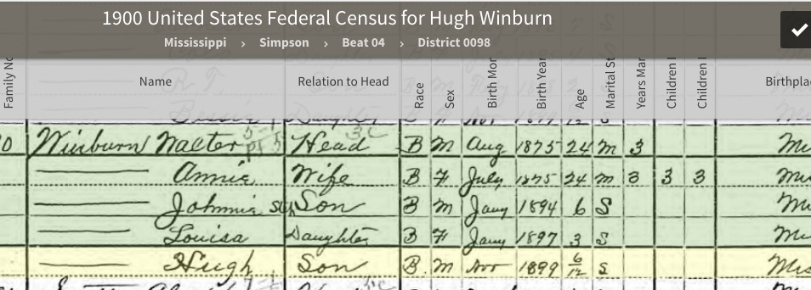
1900
6 mos. old, living with parents Walter & Annie, his older brother and sister,
Johnie (6) and Louisa (3) in Simpson Co., Mississippi.

Slide 4
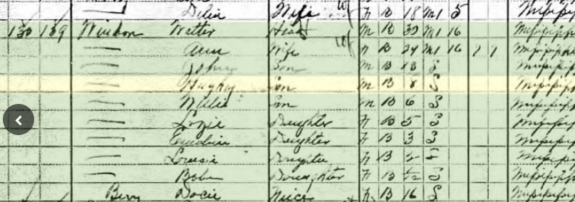
1910
The family is still in Simpson Co., Mississippi.
His father is renting (does not own land), a farmer

Slide 5
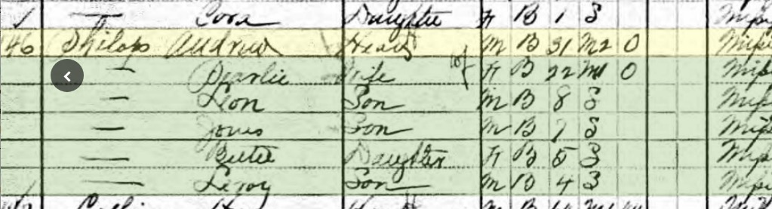
Also in Simpson Co…

Slide 6
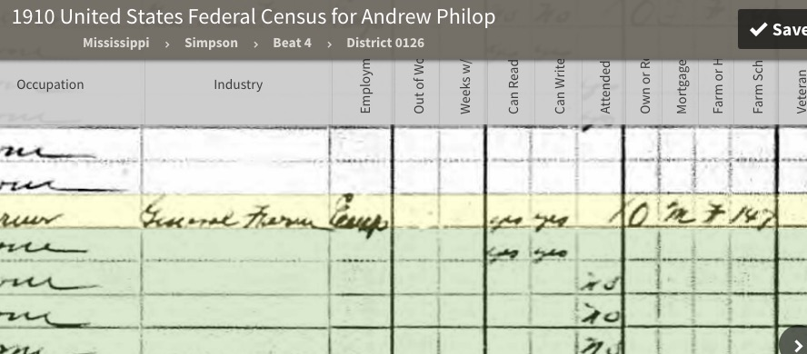
Andrew Phillips owns land in 1910
OWNS, Mortgaged,
Farm, #147 on farm
schedule

Slide 7
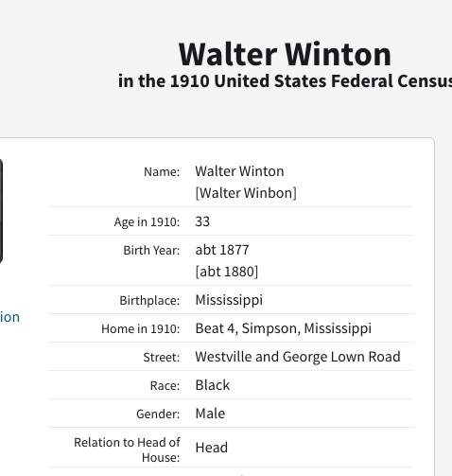
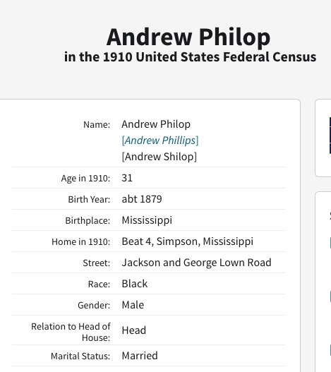
They are likely neighbors

Slide 8
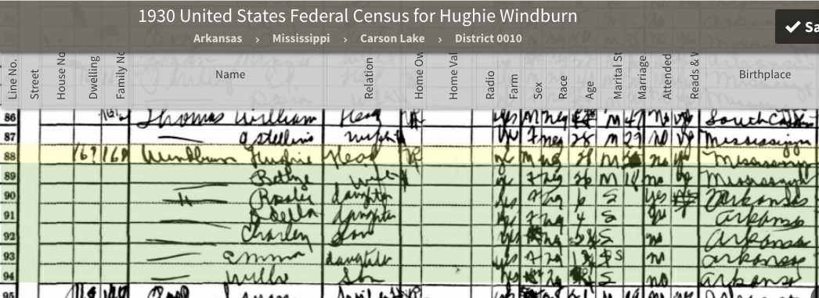
1930

Slide 9
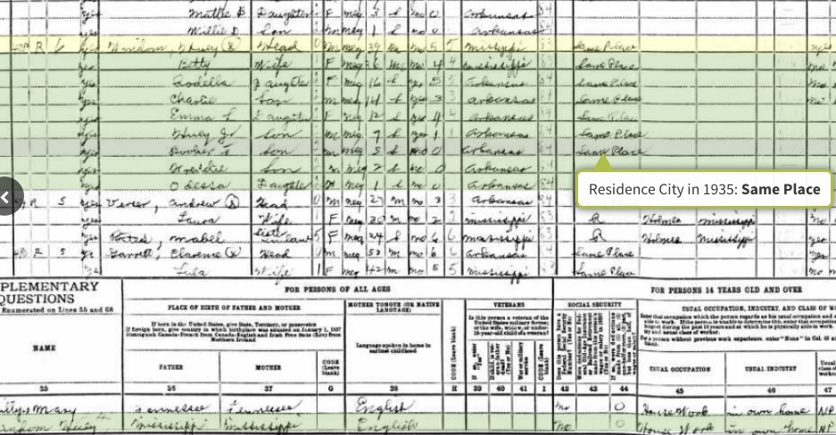
1940
Mississippi Co., Arkansas

Slide 10
Census Chronology
1900, Walter age 6mos. Simpson Co., Mississippi
1910, Walter age 8, Simpson Co. Mississipi
--Betty, age 5, Simpson Co., Mississippi
1920 Walter’s father remains in Simpson Co., Mississippi; Walter is not in the household.
1920 Do not find Andrew Phillips in Simpson Co., Mississippi – has Betty moved ?
1930, Walter& Betty married, Mississippi Co., Arkansas
1940,Walter & Betty married, Mississippi Co., Arkansas

Slide 11
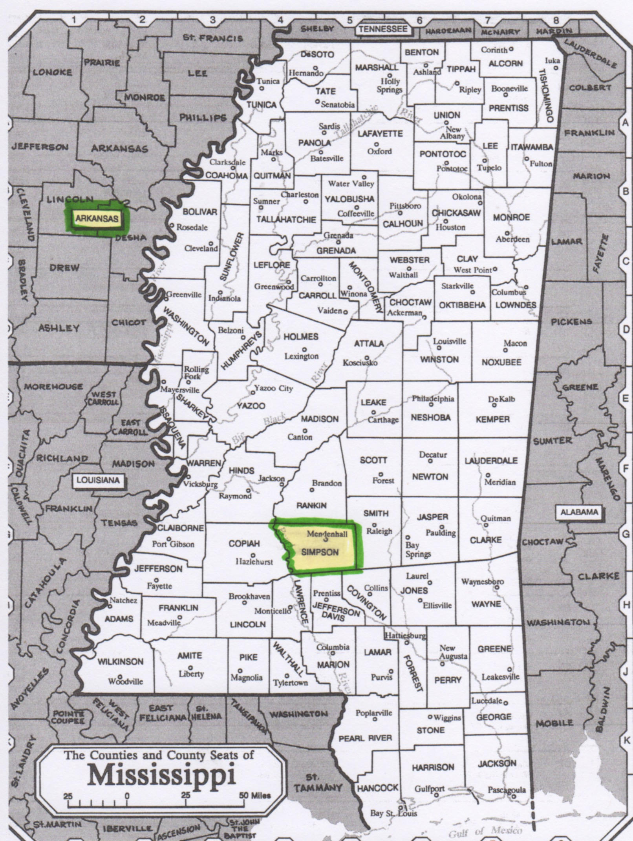
Mississippi

Slide 12
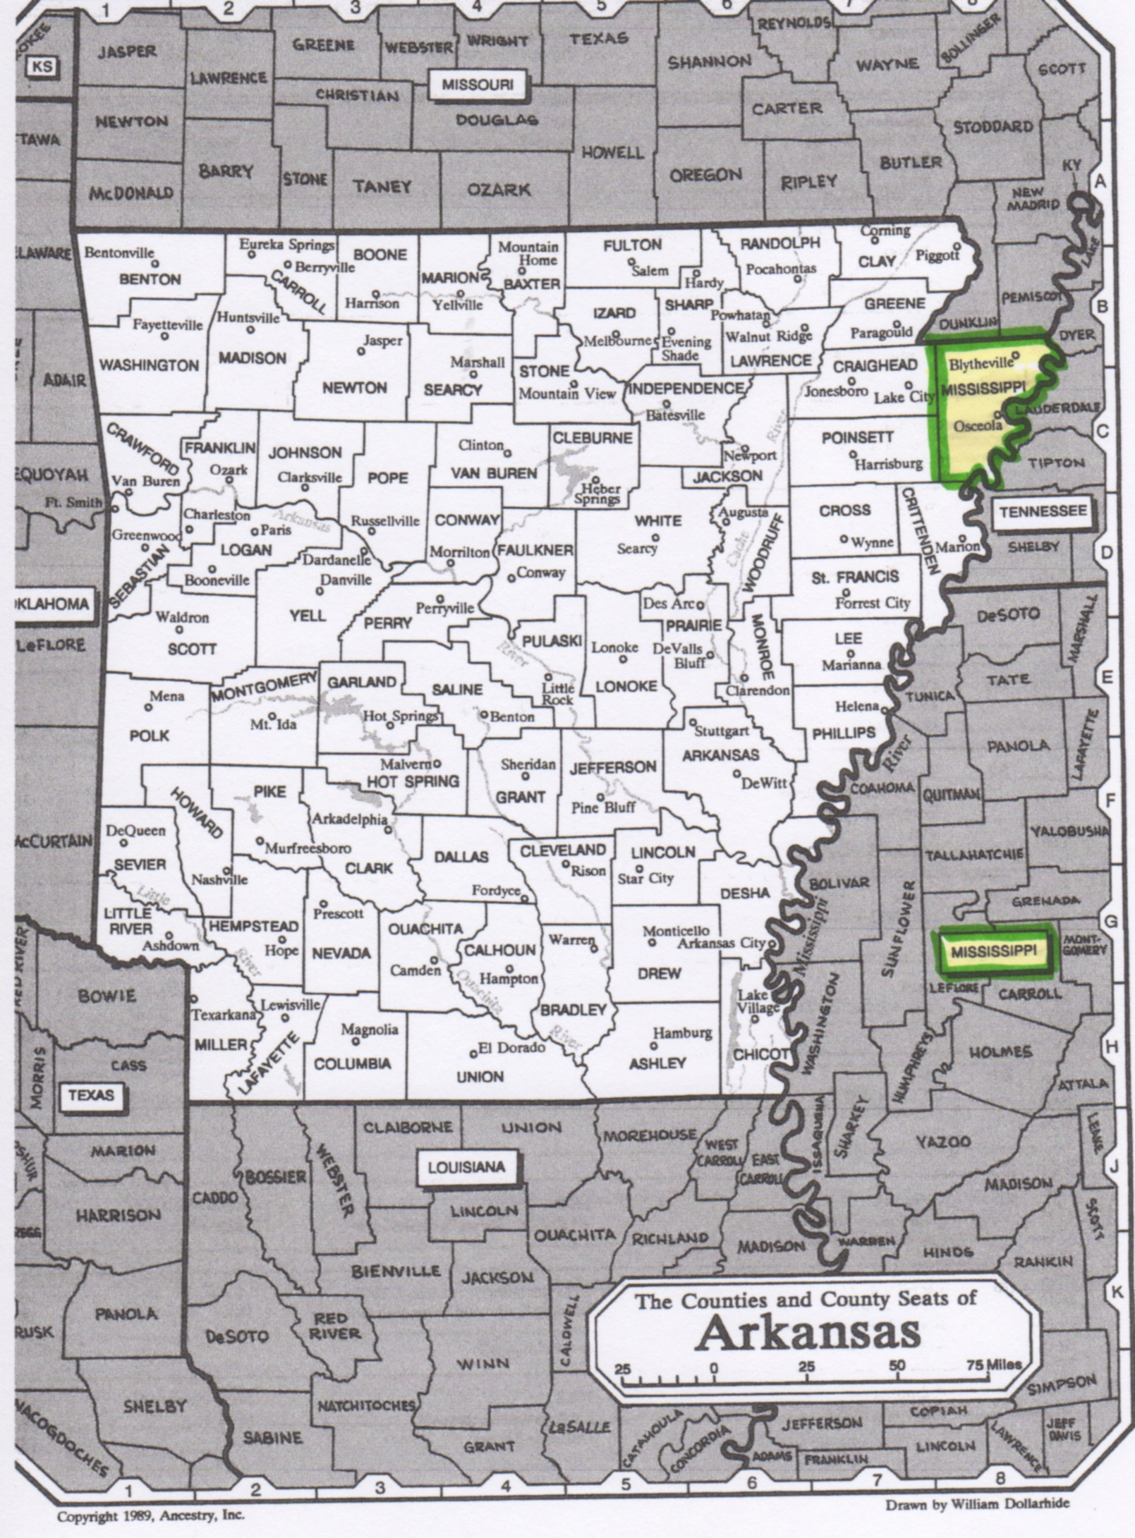
Arkansas

Slide 13
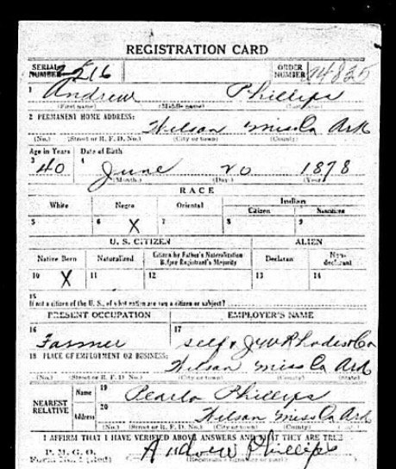
WWI Draft Registration : Bettie’s father in Wilson, Mississippi Co. Arkansas 1917-1918

Slide 14
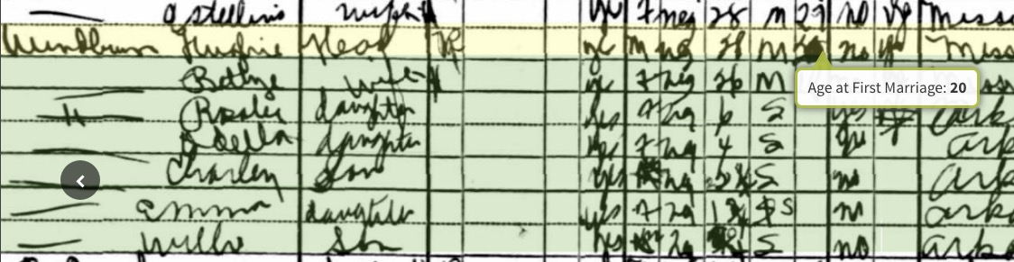
1930 census tells us when Hughie & Bettie married
Age at first marriage column
(Not always the current marriage)
He age 20, she age 15.
This record says he is 28, but we know he is closer to 30. Her age is 26,
which is about right (b. May 1904). They married about 1920.

Slide 15
This information was from an obituary
Hughie Windmon married Bettie Phillips in Golden Lake, Arkansas, on December 25, 1921, when he was 22 years old.

Slide 16
What we now know about Hughie and Bettie
They were both children in the same town in Simpson Co., Mississippi. Probably neighbors.
Sometime before 1917 Betty’s father removed to Wilson, Mississippi Co., Arkansas, where he registered for the WWI draft. Betty would have been about 13 in 1917; Hughie about 19.
Hughie’s family is in Simpson Co. Mississippi in 1920, but he not with them; he would be about 21 years old.
1921 Hughie and Betty marry in Golden Lake, Mississippi Co., Arkansas. (1930 census indicates they married earlier) No marriage record found.

Slide 17
Hypothesis
Hughie W. may have gone to Arkansas with the Phillips family. (Or he may have joined them there later)
The key to finding Hughie in 1920 might be to find the Phillips family in 1920.

Slide 18
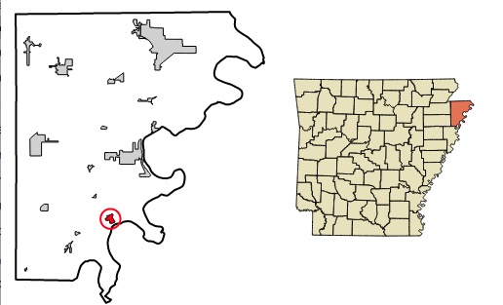
Wilson is a city in Mississippi Co., Arkansas (not a township)
It is in Golden Lake
Township.
Map from
Wikipedia entry for
Wilson, Arkansas

Slide 19
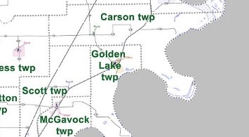
It is in Golden Lake Twp.

Slide 20
Betty’s family should be in Golden Lake Twp. in 1920
Her father registered for the draft there in 1917.
1930 census indicates children b. between 1915-1925 were born in Arkansas
An obit says she married there in 1921 – she would have been in her mid teens then.
Her ½ brother born there in 1923
Her father still there in 1930

Slide 21
A Search of the HQ /Ancestry Census doesn’t find them

Slide 22

A Search of FamilySearch.org doesn’t find Andrew b. 1875 wife Pearlie b. 188, but it does find:
Andrew b. 1875 Alabama, parents b. Alabama
Josie b. 1884 George, parents b. Georgia
No children in household
What do we make of this entry?

Slide 23
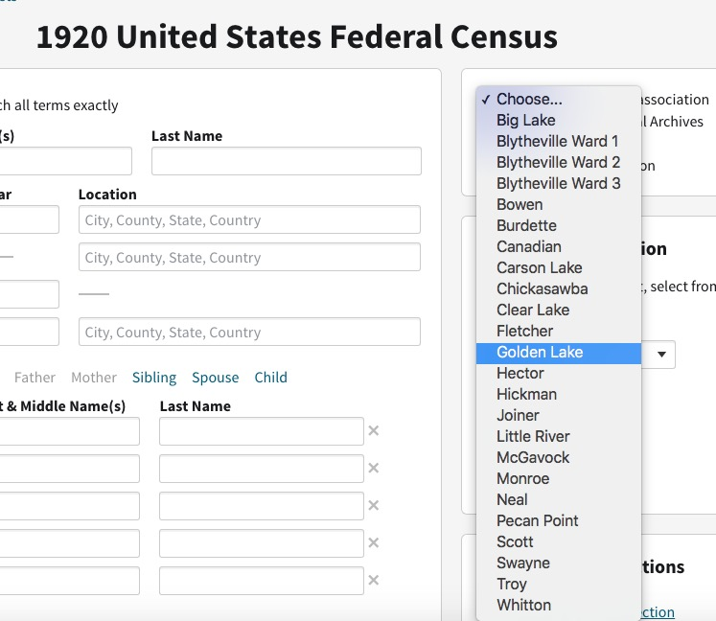
When indexes don’t work, you can go through a census page by page

Slide 24
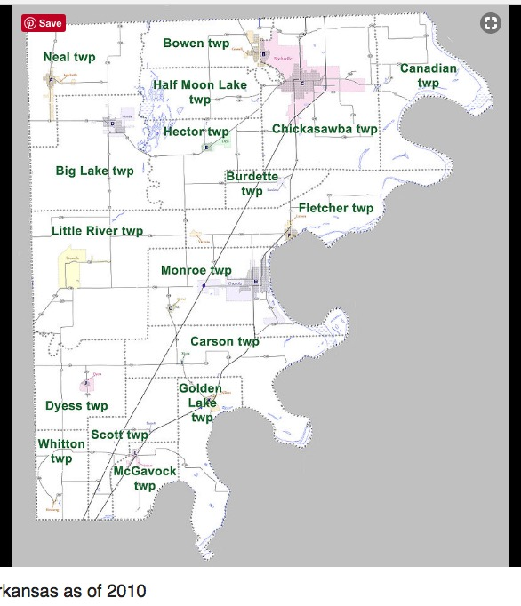
Townships in Arkansas do not function like those in Michigan, but are used in census enumerations.

Slide 25
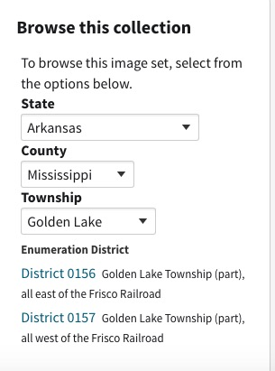
Golden Lake is in two parts

Slide 26
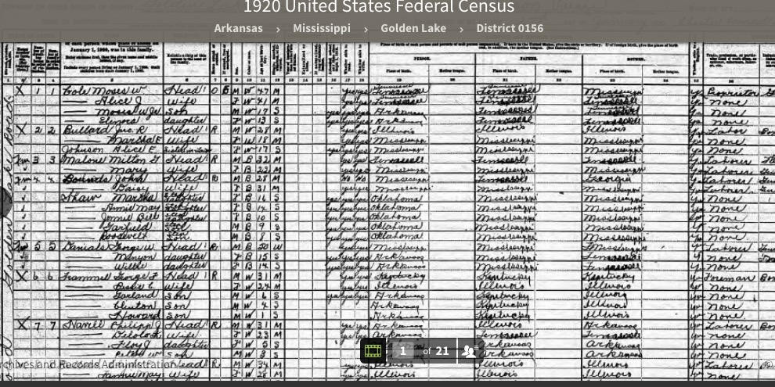
Good news, bad news…
Neat handwriting
21 pages
Notes:
If the handwriting is neat, the bad news is that it was less likely to get misread.

Slide 27
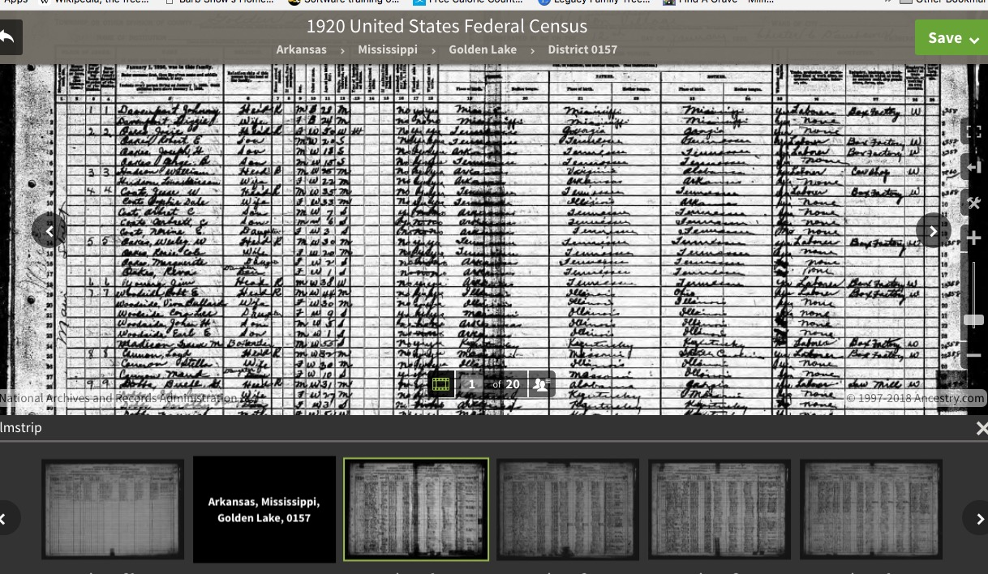
Don’t forget you have two districts to check
Close the navigation pane with the X upper right

Slide 28
Read the entries very carefully
Sometimes people are enumerated under a completely wrong surname or other major error.
And if that doesn’t work… what’s next?
  Don’t give up.
  Don’t assume not enumerated
  But you may have to set it aside until you can get
  more information

Slide 29
Wait! Renita found Andrew in 1920!!
Starting with what you know…
Notice the neighbors...
From prior research she knew:
  “ Penilton or Pendlton, family are always near by, so I assumed they are related in some way because they show up in Mississippi and Arkansas around my family.”

Slide 30
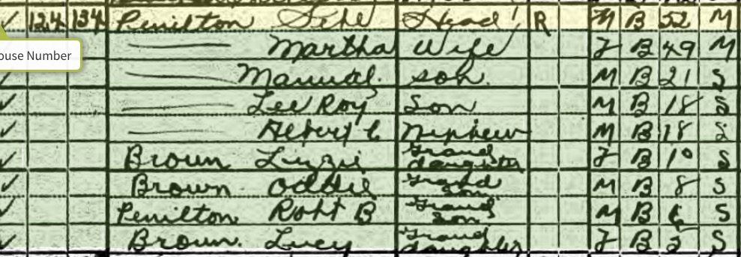
Penilton Family in Golden Lake, Mississippi Co., Arkansas 1920

Slide 31
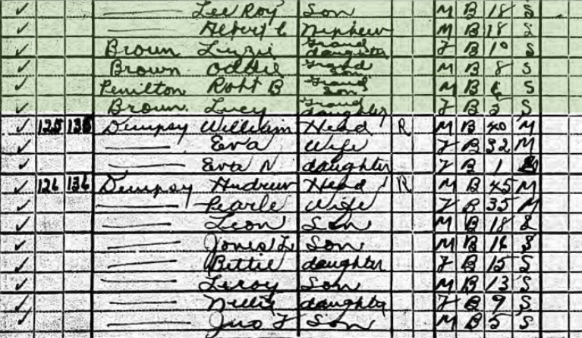
Check nearby families

Slide 32
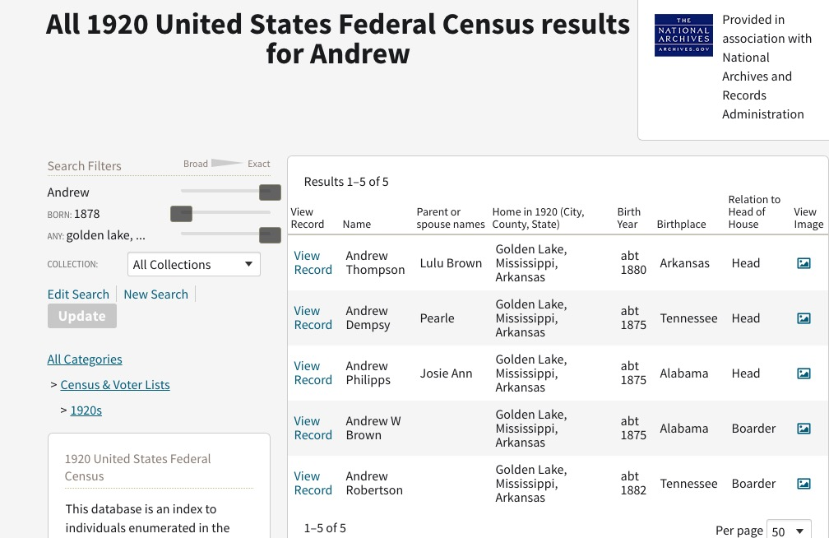
I had done a first name only search; why didn’t that work?

Slide 33
We are still trying to find Hughey Winborn in 1920
Now we know one more thing:
  Hughey Winborn was not living with his future father in law in 1920.
  What’s next?

